Slide 1
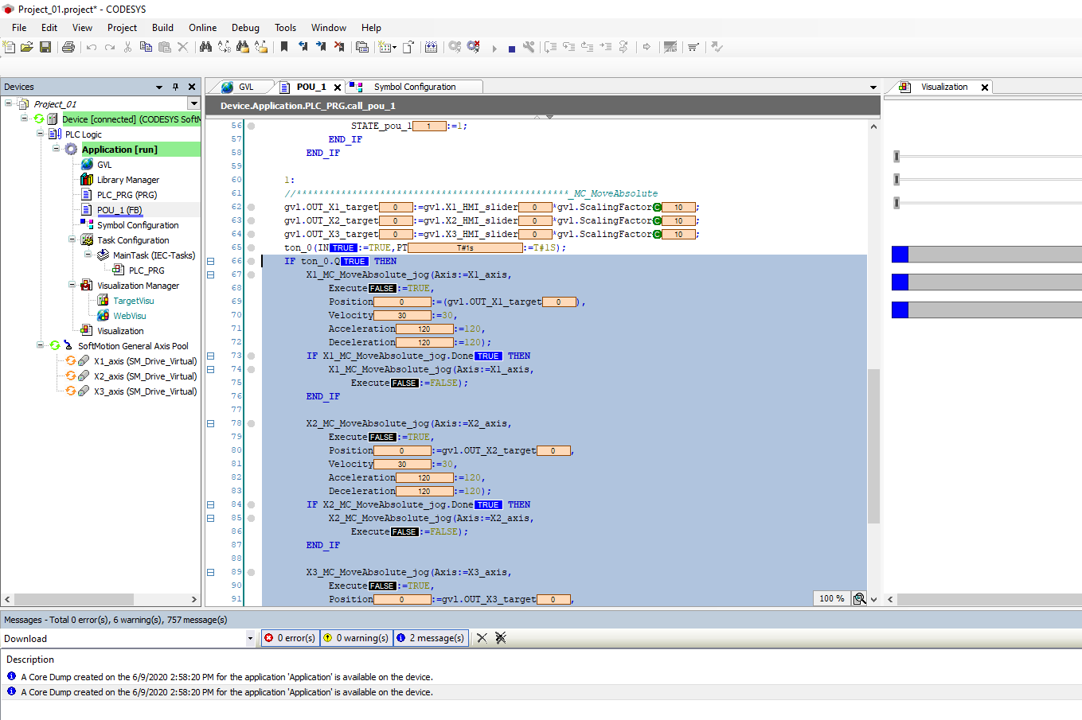
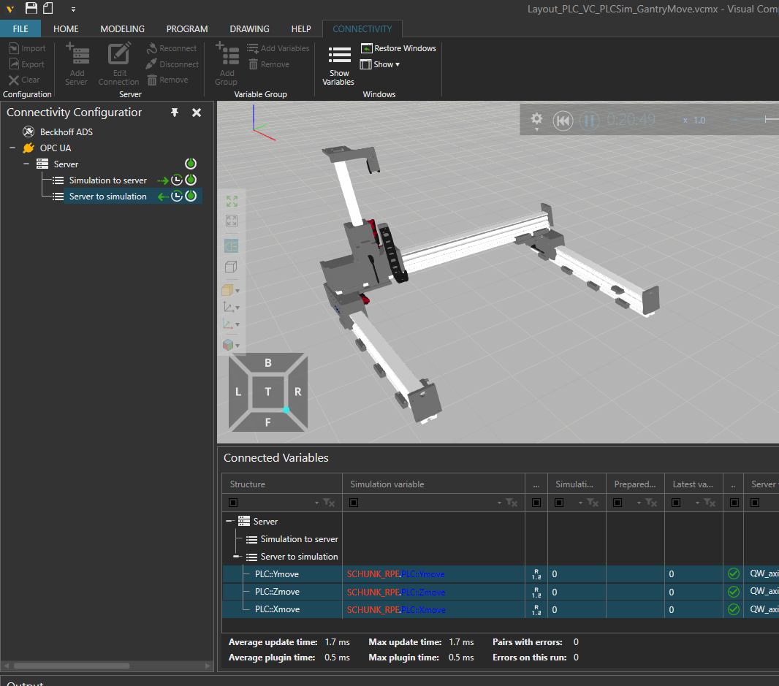
Server
Client
OPC-UA
Codesys (Virtual PLC)
Visual Components (Virtual Machine)

